Slide 1


The Melcom Way
A Legacy of Innovation, Evolution
&
Growth in Ghana

Slide 2


“With hard work and, hopefully, a bit of luck along the way,
Surely you will fly with the birds, if not touch the stars.”
- BHAGWAN RAMCHAND KHUBCHANDANI
FOUNDER

Slide 3







Who We Are..
Melcom Group is one of Ghana’s largest and most diversified business conglomerate with interests in
Founded in 1989, Melcom is “ Where Ghana Shops”
Retail
Manufacturing
Electronics
Travel
Hospitality
Health & Wellness
Social impact.

Slide 4
STRATEGY :Our Pillars
36 years of Retail experience in Ghana – “The largestorganized home grown retail entity”, Truly where GHANASHOPS.
We know the customers better than anyone else does.
Expanse / Network – 80 + multi format retail stores
The Value chain – Sourcing , Warehousing, Logistics & Sales(Retail Wholesale & Online ) all under the same roof.
Brick to Click – 2ND largest Ecommerce platform with MAU inexcess of 200,000.
Loyal Customer Base – The Supersaver Club - the largestRetail Loyalty program in the region with 1 million members.
•Retail Experience
•Products & Processes
•Customer & Brand Centricity

Slide 5
Hence an Omni Channel Retail Platform .
Melcom Connect
B2B- GT
Electronic & Mobile Commerce
Social Media
Brick & Mortar
Creating a seamless Omni channel for the brand and customers via our One View platform – MELCOM CONNECT

Slide 6
What We’ve Built so far…..
An E-Commerce platform
60+ Melcom retail stores
2 Melcom Electric stores
12 Cash & Carry depots
9 Melcom Mini (7 / 11) stores
5000+ employees
2M+ sq ft of retail space
700,000 sq ft warehouse space
Serving 25M+ customers annually
4 international franchises
45 Restaurants

Slide 7

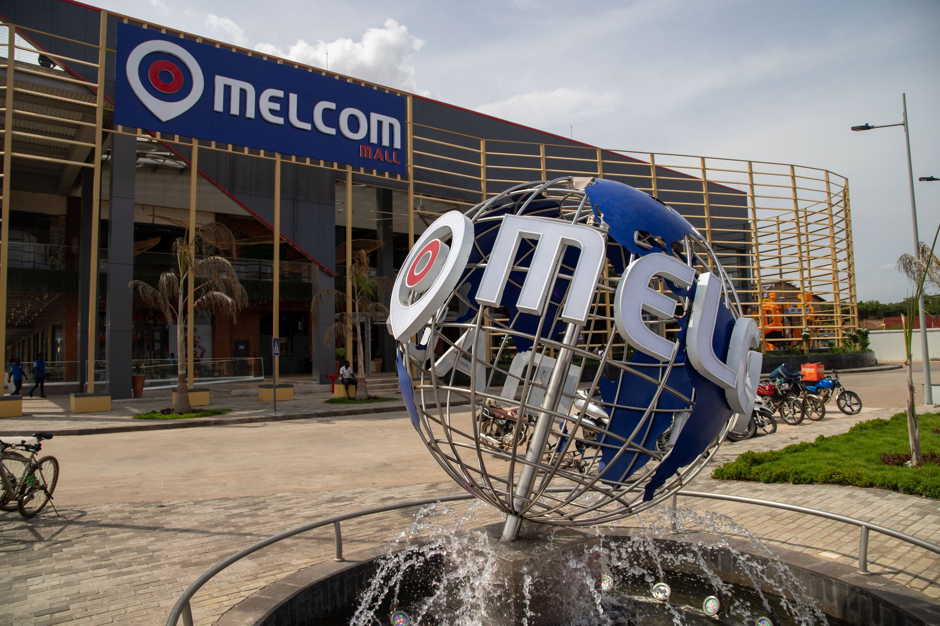
Retail Excellence
Melcom Limited is Ghana’s #1 retail chain. Offering over 50,000 products across multiple categories Melcom serves as the go-to destination for household needs, an online store, loyalty program & Omni-channel strategy further elevate its customer reach.

Slide 8





Melcom Limited​
Melcom Limited was established in 1989 and the doors of the first Melcom store in Accra Central opened. In 2017 Melcom Limited launched an online store - www.melcom.com. In 2020, Melcom Hospitality was merged into Melcom Limted ​
Century Industries Limited​​
Century Industries Limited was established in 2000 and expands every four years.​​
Melcom Travels Ltd.
Melcom Travel and Tours Limited was established in 2005 and launched its online booking site in 2019.
Melcom Care Foundation
Melcom Care Foundation looks after the Corportate Social Responsibility and was established in 2006 focusing on Healthcare and Education.
Melcom Travels Ltd.​
Melcom Travel and Tours Limited was established in 2005 and launched its online booking site in 2019.​

Slide 9








Group of Companies
Melcom Mini was incorporated into the Melcom family in the year 2021, from which we have opened 4 shops as standing, and expected to expand to other locations, as part of our strategy of making grocery shopping convenient
This division of Melcom Limited was added to our group of companies with the focus on providing a unique sense of interior and exterior decorative designs from our vast ranges of fine quality products in beautifying homes and offices amongst others for our diverse customers.​
​
At Melcom, we embrace emerging technologies to enhance customer satisfaction. We've launched an online shopping portal to guarantee quality service with every order. Our goal is to expand this safe, convenient shopping experience across all our locations and beyond.
Crownstar Electronics was merged into Melcom in 2022. They serve as the after sales service center for all electronics & electricals as well as assemble televisions, gas cookers and other product ranges locally.
Melcom Group aquired the exclusive distribution rights to open the first crocs store in December 2022.
The footwear brand is currently available in 2 Melcom stores and is expected to be in Melcom stores within the year.
Arcadia - a state of the art virtual reality gaming zone was launched in 2021 for it’s customers. It will be introduced in 2 other locations in the current year.
Activ8 (Gym & Spa), introduced in 2023, Is a gym and wellness center aimed at promoting the well being of​
Ghanaians.​
​
Melcom added this distinctively thrilling playground which was established in 2021, as an add-on, whereby kids can enjoy amusing moments. Part
of our growth strategy is to add more kids’ play centers in selected store locations.
Melcom Group aquired the franchise and opened the first Giordano store in 2021

Slide 10


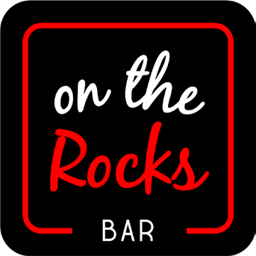




Food & Beverages
Pizza Hut
Pizza Hut, the global quick service restaurant brand, was relaunched by Melcom Group’s subsidiary Skyline Investments Limited in November 2021, with seven restaurants opened by the end of December 2021 and expanding across major cities in the years. Skyline was merged with Melcom in 2022.
The Art Kitchen
The Art Kitchen, which started in 2022, is an in-store restaurant that provides both local and continental dishes and will be expanding in Melcom stores within the year.
On The Rocks Bar
On The Rocks Bar was established in 2022 and aims to be the go-to entertainment spot. It will be embarked upon a major expansion in more locations.
Hallab Gourmet 1881
Hallab Gourmet 1881 is a leading Lebanese restaurant brand that Melcom is adding to its businesses in 2023.
Sip Cafe
The Sip Cafe - an in-store cafe - was first opened in 2022 and is set to be in other Melcom stores soon.
Maharaja Indian Cuisine
Maharaja Indian Cuisine is an in-store Indian restaurant
to be established in 2023 and focuses on Indian cuisine.
Yole
Yole is a Spanish ice cream brand that is being introduced
in Melcom in 2023, for the first time in Ghana.

Slide 11
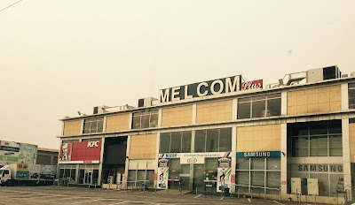
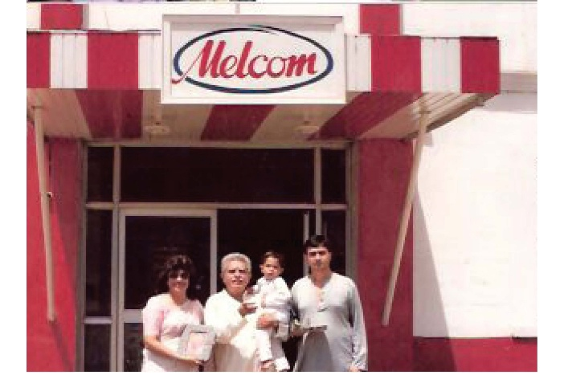
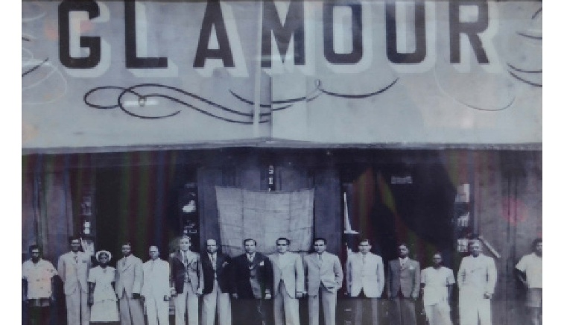
Our Journey so Far…
2009 - Melcom Plus Concept
Rejuvenation & focus on introducing world-class brands and categories.
1989 - First Melcom store
1946 - Glamour Stores

Slide 12



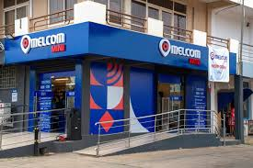
Our Journey…( 2021)
The new identity via its architecture and colors demonstrates it’s values of being:
Brand Rejuvenation - New Logo
Trustworthy, Reliable & Calm - BLUE
Bold, Strong & Energetic - RED
Sophisticated, PURE and Pristine - WHITE
New concept Melcom Mini stores 7 am to 11 pm, neighborhood store

Slide 13
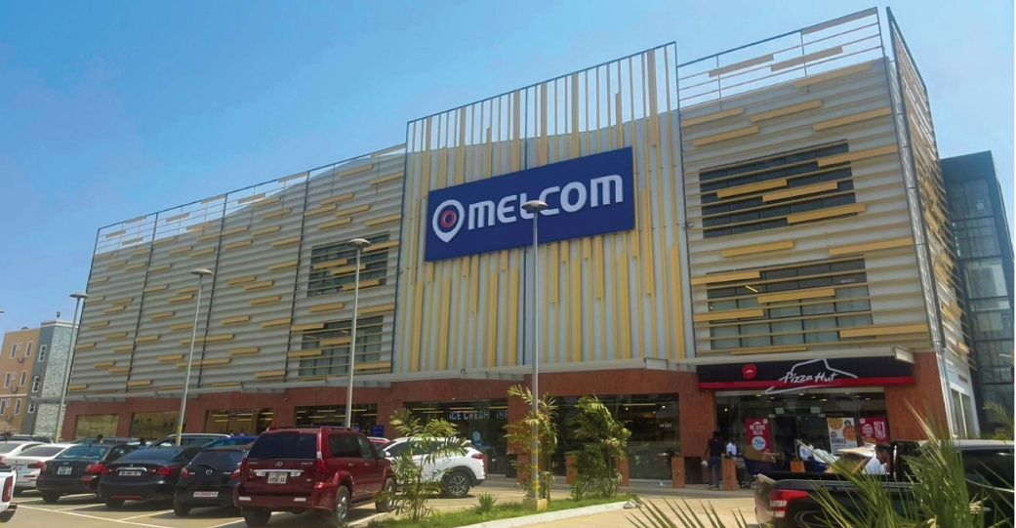



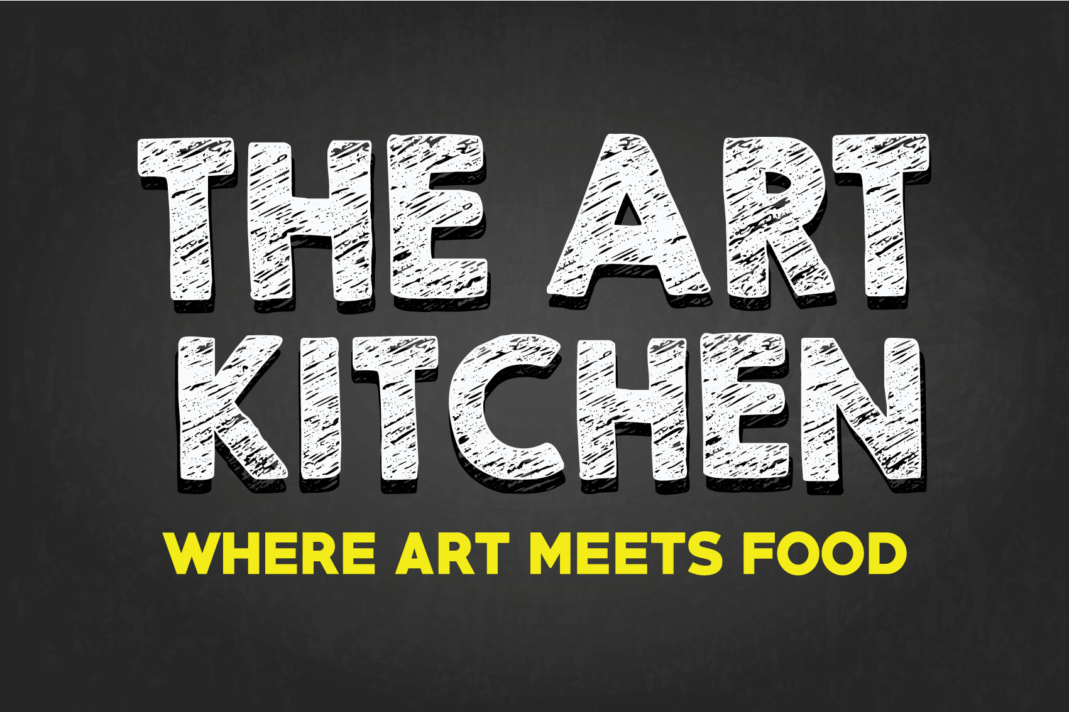
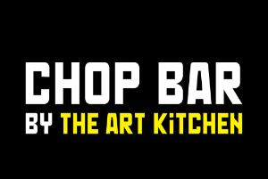
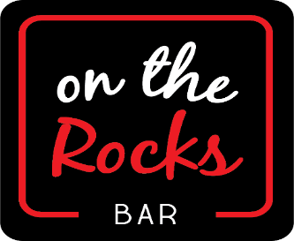
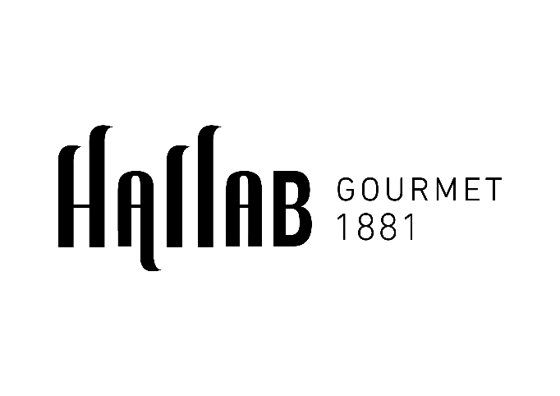


Our Journey…2022
2022 – New Concept Melcom Store, Global Franchise
Our Journey…2023
Melcom adds more food concepts, Gym, play zones & Gaming Zones to its portfolio

Slide 14

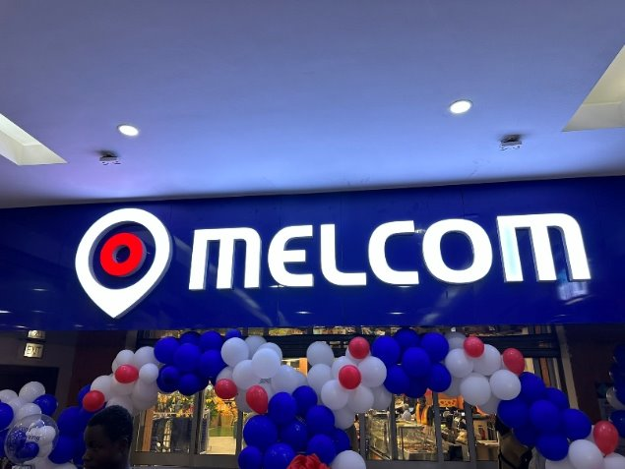

Our Journey …..
Melcom opens our Super store and mall –Melcom Mall –Spintex
Melcom introduces its first state of art GYM- Activate
2024 - Melcom enters independent malls ​
West Hill Mall​
Accra Mall​
Kumasi Mall ​
​2025 – New Concept restaurant​
Japanese Cuisine . Melcom starts AchimotaMall​​
& We continue to Evolve & Re-Invent…..

Slide 15
Corporate Social Responsibility
Through the Melcom Care Foundation:
Donates to large number of health institutions
Built classrooms and washrooms for schools
Supported education through scholarships
First responders during national emergencies
Annual blood donation drives

Slide 16


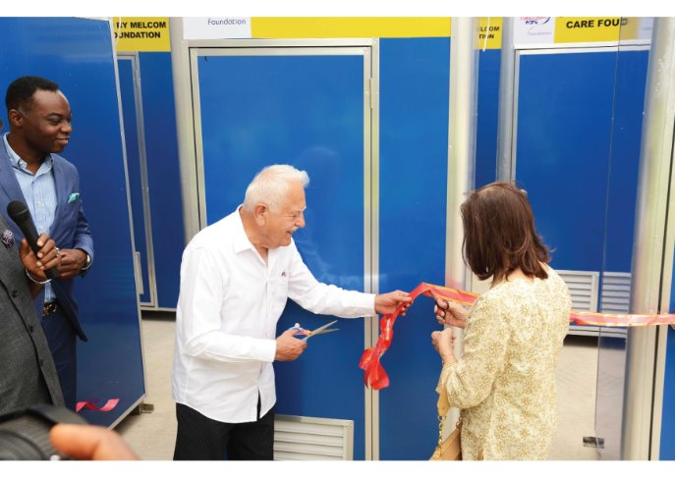

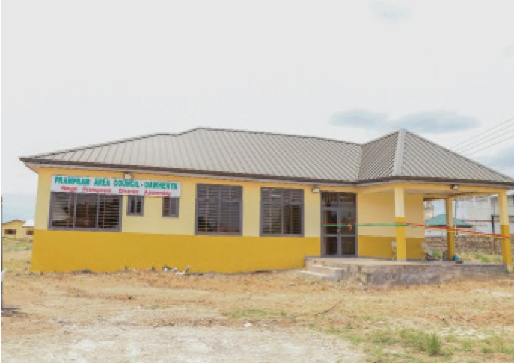
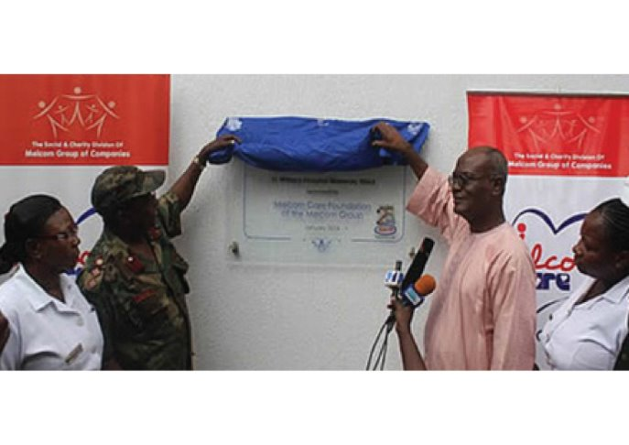


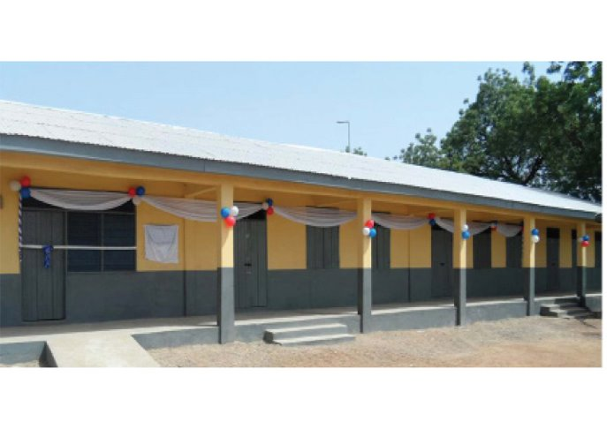
Giving back to Society…

Slide 17
Sustainability Initiatives
Melcom’s eco-programs include:
Solar energy in 10+ locations
Biodegradable shopping bags
Cardboard recycling (4M+ cartons)
Rainwater harvesting & bio-fil digester systems
EDGE green building compliance

Slide 18
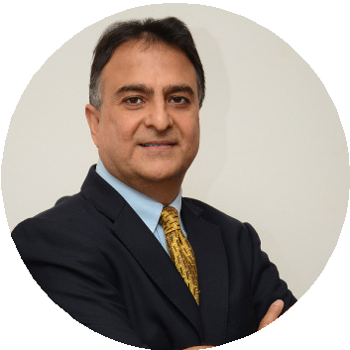
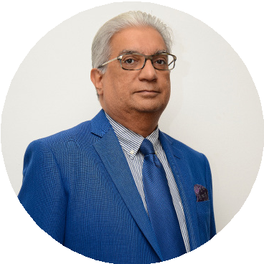



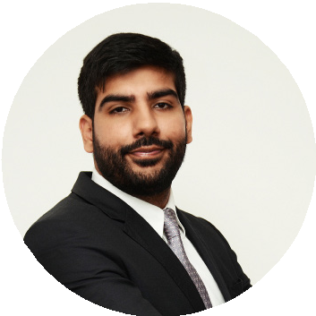
Our Leadership Team
Board of Directors​
Mahesh Melwani
Group Managing Director
Ramesh Sadhwani
Group Managing Director
Sonya Sadhwani
Group Executive Director
Group Directors
Rishi Melwani
Manoj Sadhwani

Slide 19
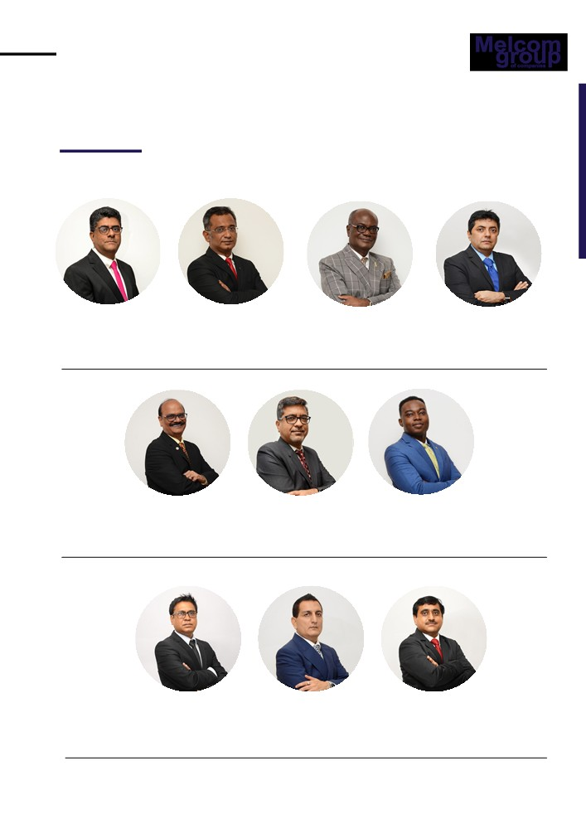
Our Leadership Team
Ashok Nair
Raja Udhwani
Chief Operating Officer
Chief Procurement Officer
Sushil Jha
Manish Malik
Francis Sam
Head of Audit
Chief Financial Officer
General Manager
Rupesh Singh
Narinder Singh Zahed Siddiqui
Group Chief Officer - Projects
Chief Business Chief Information Officer Development Officer

Slide 20
Looking Ahead
Melcom aims to expand its
Retail footprint
Bring in more global brands,
Invest in digital innovation and deepen its social impact
“All while remaining Ghana’s most trusted and beloved retail brand."

Slide 21
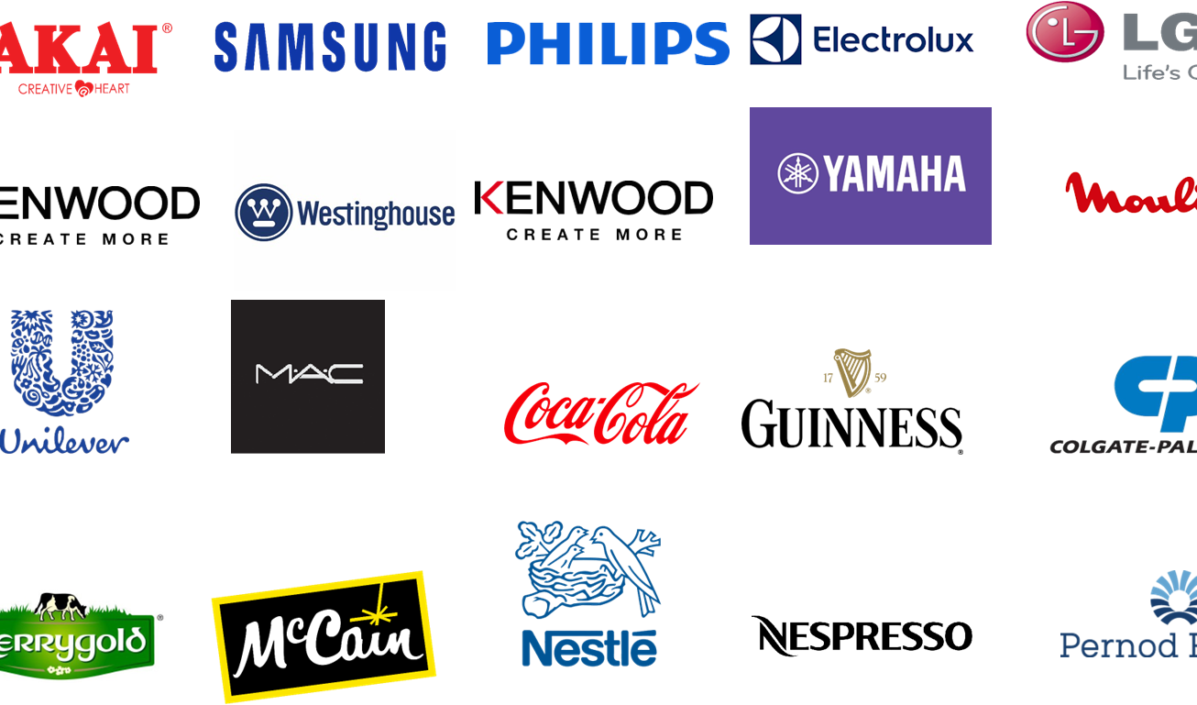
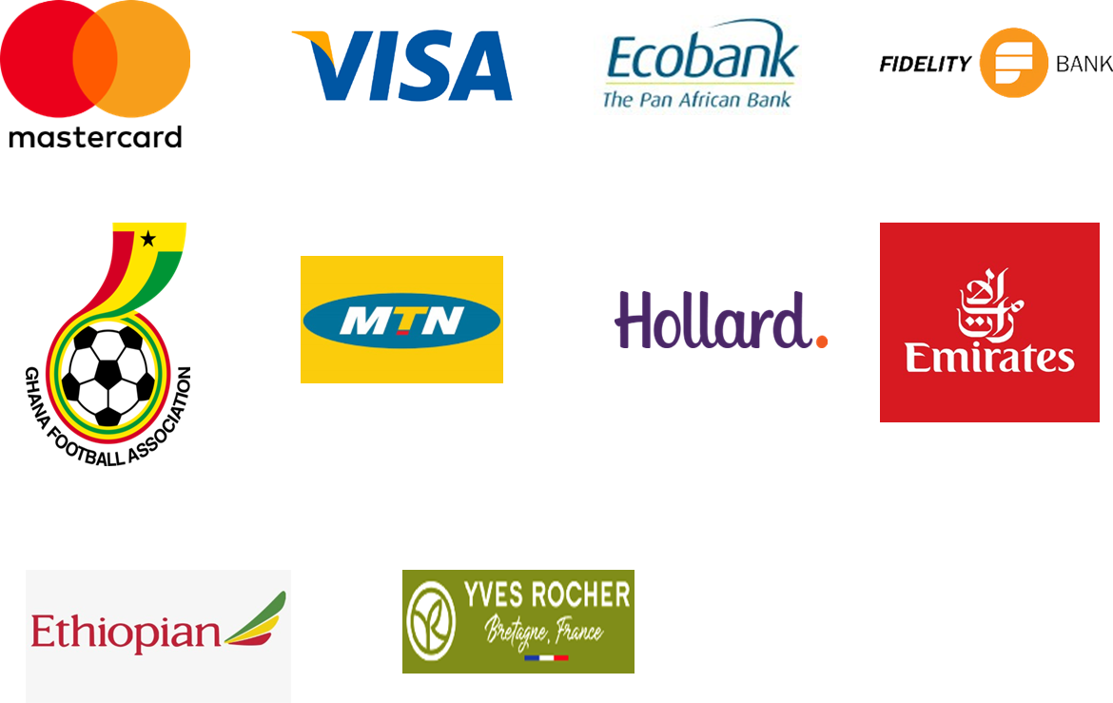
Brands that we Collaborate with….

Slide 22
Thank You…

